Slide 1
Does Rust SPARK joy?
Recommendations for safe cross-language
bindings between Rust and SPARK
Aïssata Maiga
Supervisors: Cyrille Artho (KTH), Florian Gilcher (Ferrous Systems), Yannick Moy (AdaCore)
Examiner: Elena Troubitsyna

Slide 2
Problem statement
Memory errors come from unsafe languages[4] → safety-critical, systems programming, low level
Bindings usually done through C/C++ → too much freedom == too much responsibility!
FFI in software engineering is difficult and error prone [1]
FFI safe/unsafe languages is potentially more unsafe than the rest [2]

Slide 3
Research question
What are the best practices for secure bindings between safe languages Rust and SPARK?
Goal: Recommendations for binding safely Rust and SPARK by preserving type and memory safety, as well as ownership
Limitations: Preliminary research from automated tool

Slide 4

Background 1: Ferrocene
Ferrous Systems/AdaCore project
Qualification of one version of the Rust compiler
Produce certified code

Slide 5
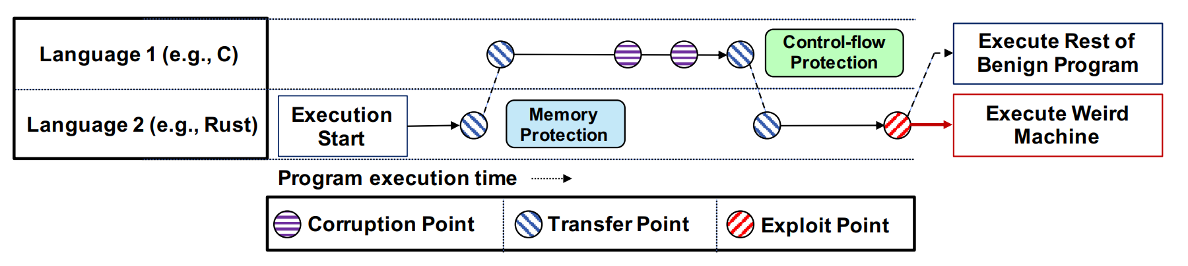
Background 2
Unsafe languages: 70% of memory errors[4]
Safe/Unsafe languages: potentially more unsafe than safe/unsafe combinations[2]
FFI resussitate old avenues of attack → weakest link
Cross-Language Attacks (CLA) transfer back and forth between languages to circumvent deployed defenses. Mergendahl et al., [2]

Slide 6
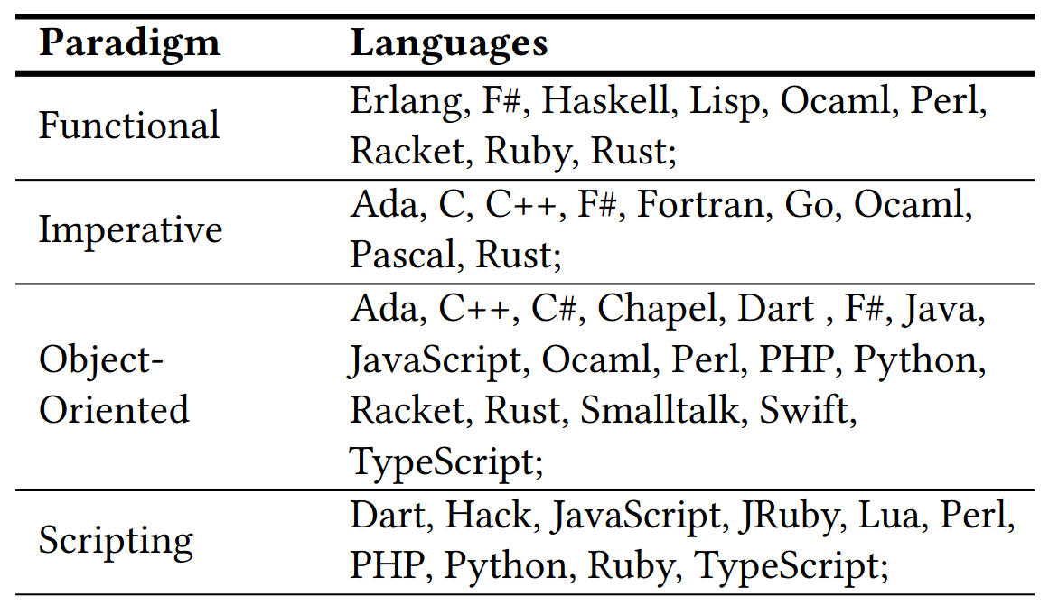
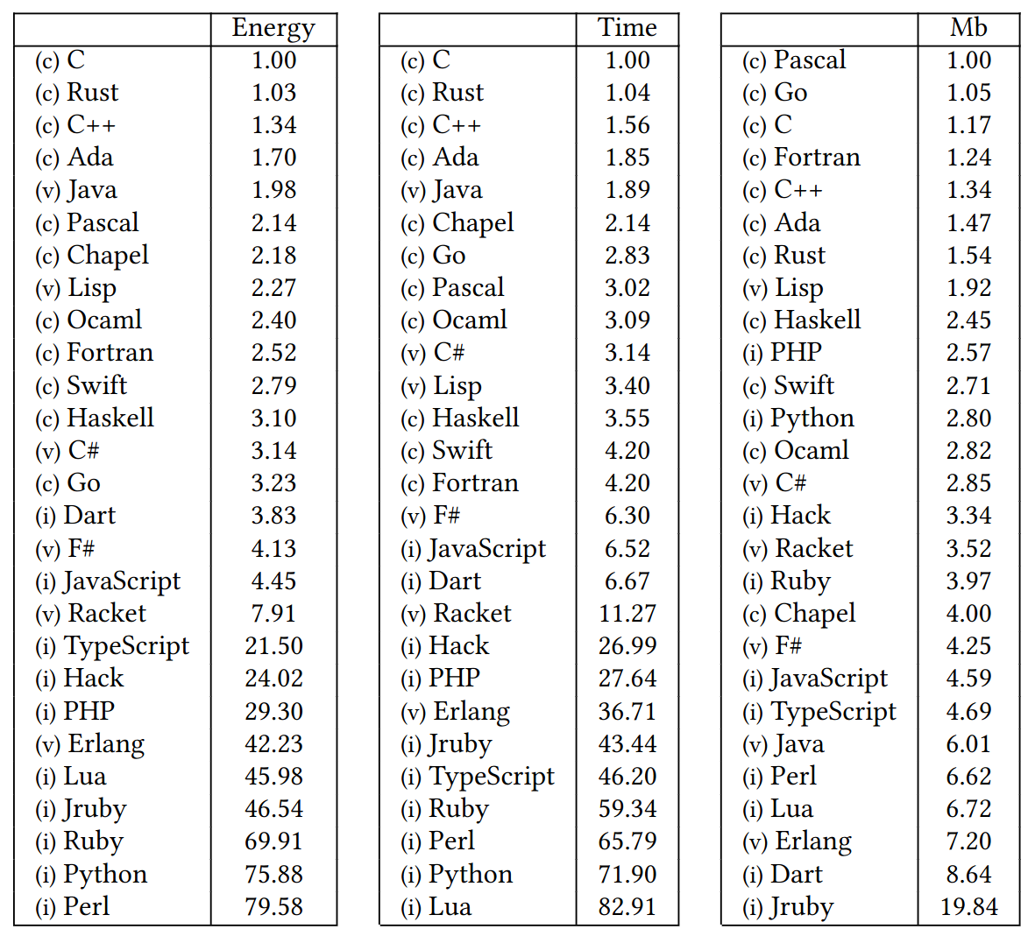
Background 3: Rust and SPARK
Energy Efficiency across Programming Languages
How Do Energy, Time, and Memory Relate?
R. Pereira et al.[3]

Slide 7
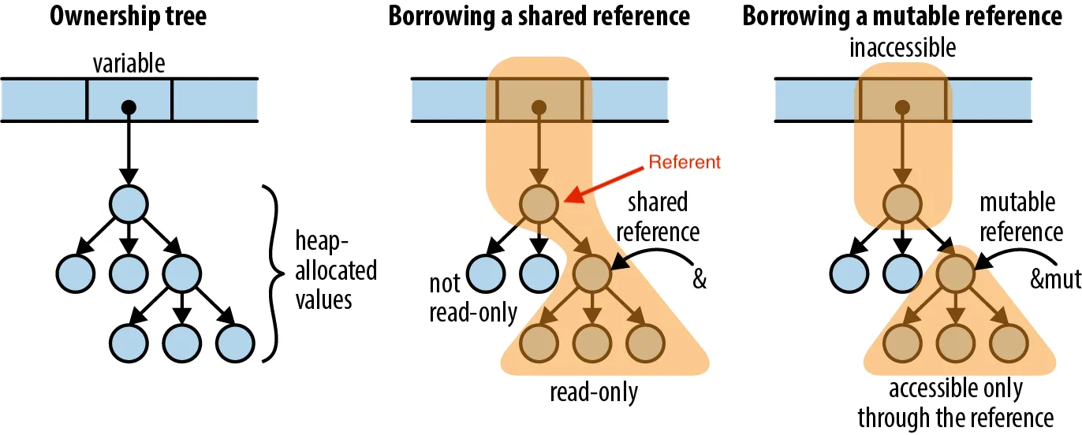
Background 3: What is ownership?
Rust ownership:
- one place in memory has one owner
- the compiler annotates the types with lifetimes
- the compiler removes the memory when the owner is out of scope.
SPARK ownership:
- inspired by Rust
- the programmer need to implement cleaning functions
- the compiler will not throw an error in case of illegal operations
“Understanding Ownership” Luis Soares [5]
fn main(){
let a = String::from("foo");
moving_out(a); // a is moved here to moving_out function
println!("{}", a);
}
fn moving_out(a: String){
// a goes out of scope
}
error[E0382]: borrow of moved value: `a`
3 | let a = String::from("foo");
| - move occurs because `a` has type `String`, which does not implement the `Copy` trait
4 |
5 | some_stuff(a);
| - value moved here
6 | println!("{}", a);
| ^ value borrowed here after move

Slide 8
Background 4: Rust safety guarantees
Rust is a strong typed language. Type safety, memory safety and ownership.
Unsafe Rust allows to deviate from the borrow checker but invariants must be followed

Slide 9
Background 5: SPARK safety guarantees
SPARK
- biggest possible subset of Ada with specification and sound verification.
- Pointers added in 2019 with Rust ownership
- Support for mathematical proofs: absence of runtime exceptions, verify the fulfillment of security and safety properties, or establish that the software follows its specifications/behavior

Slide 10
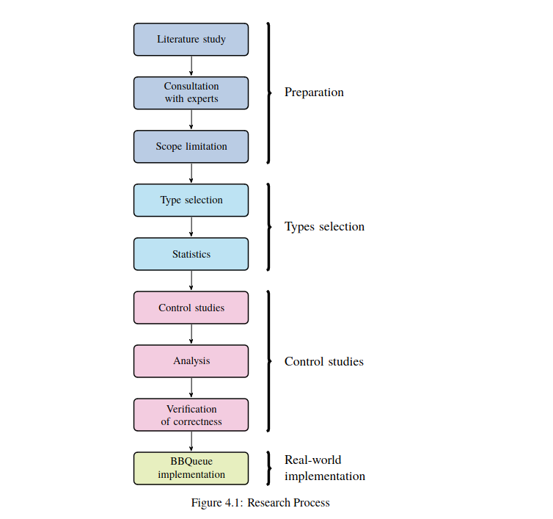
Method 1: Overview
Method

Slide 11
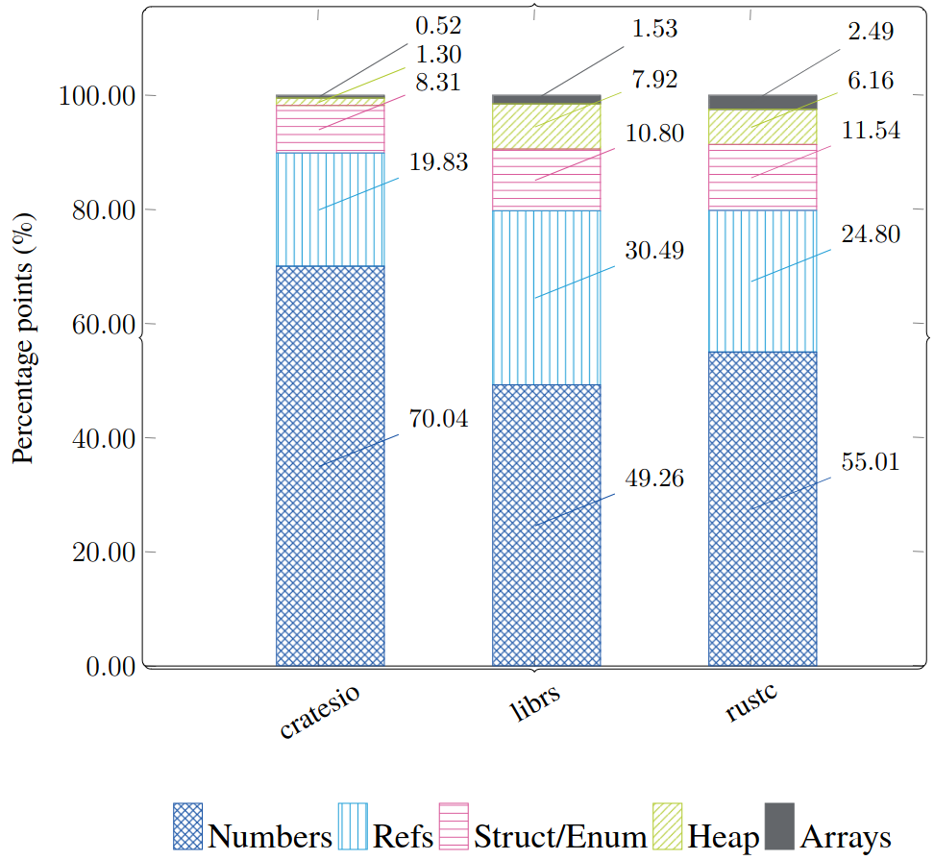
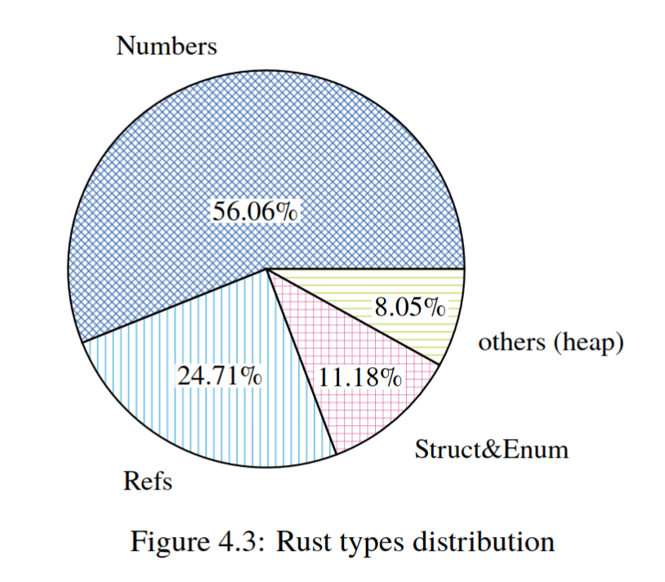
Method 2: Rust Type selection
- About 2MLoC
- Compiler, crates.io, lib.rs (17 important rust projects)
- A systems’ programming language profile.
Method

Slide 12
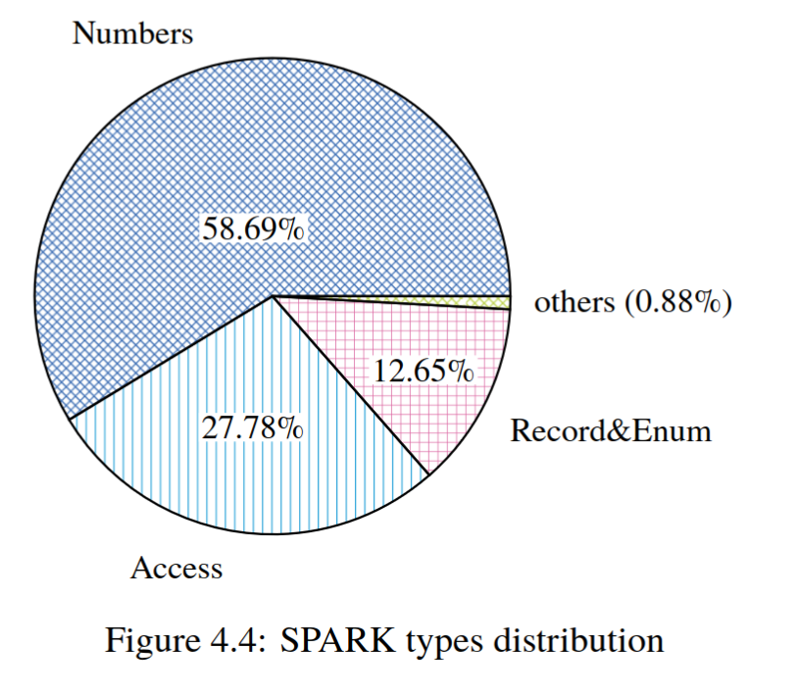
Method 3: SPARK Type selection
- 27 kLoC for SPARK
- Three OSS projects
→ Code base are proprietary
- Low-level language, very little heap types
Method

Slide 13
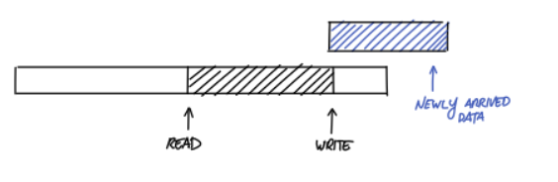
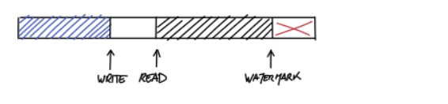
Method 4: BBQueue
Bipartite Buffer
Optimized for DMA in embedded systems
Concurrency ensured by reading atomic variables: lock-free implementation
#[derive(Debug)]
#[repr(C)]
pub struct BBBuffer {
// Pointer to:
// Box<UnsafeCell<[u8; 128]>>, it is an “Option” for embedded systems
pub buf: AtomicPtr<u8>,
pub buf_len: AtomicUsize,
/// Where the next byte will be written
pub write: AtomicUsize,
/// Where the next byte will be read from
pub read: AtomicUsize,
/// Used in the inverted case to mark the end of the
/// readable streak. Otherwise will == sizeof::<self.buf>().
/// Writer is responsible for placing this at the correct
/// place when entering an inverted condition, and Reader
/// is responsible for moving it back to sizeof::<self.buf>()
/// when exiting the inverted condition
pub last: AtomicUsize,
/// Used by the Writer to remember what bytes are currently
/// allowed to be written to, but are not yet ready to be
/// read from
pub reserve: AtomicUsize,
/// Is there an active read grant?
pub read_in_progress: AtomicBool,
/// Is there an active write grant?
pub write_in_progress: AtomicBool,
}
“The design and implementation of a lock-free ring-buffer with contiguous reservations[6]
Method

Slide 14
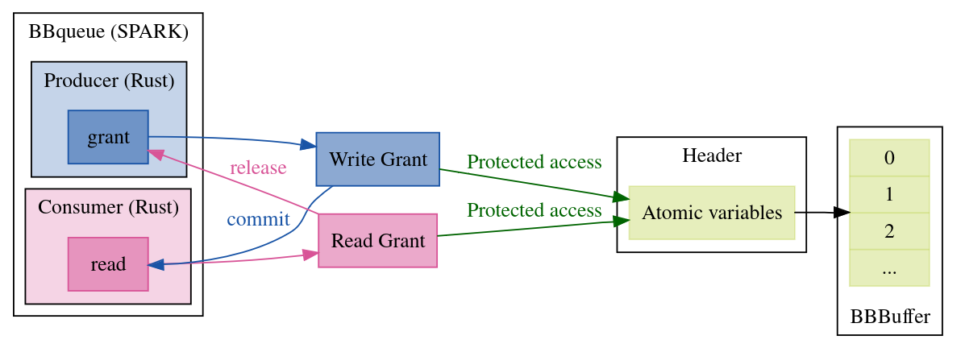
Method 5: BBQueue
Bipartite Buffer
Exists in Rust and SPARK
Formally proven in SPARK with invariants and the GNATprover
Data structures are complex enough, continuous memory blocks which makes it ideal for experiment
Method

Slide 15
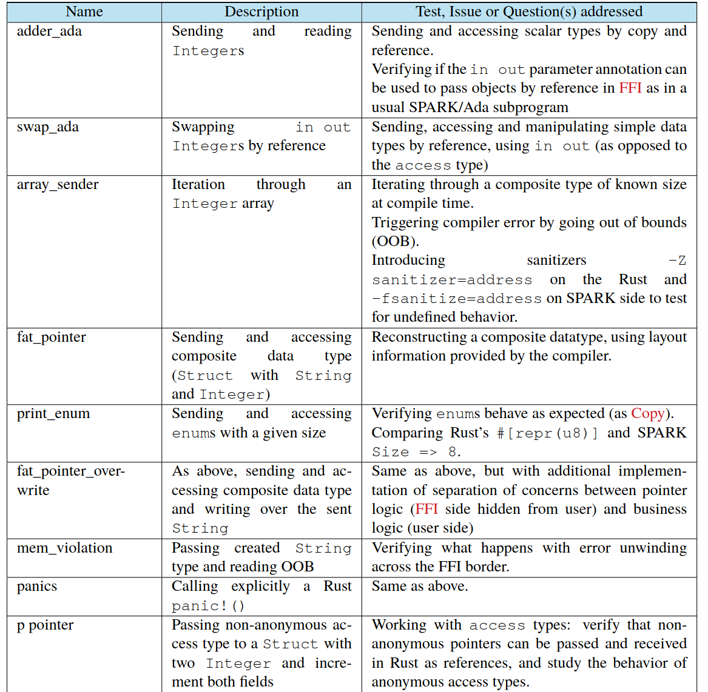
Experiments (1) Rust → SPARK
Experiments

Slide 16
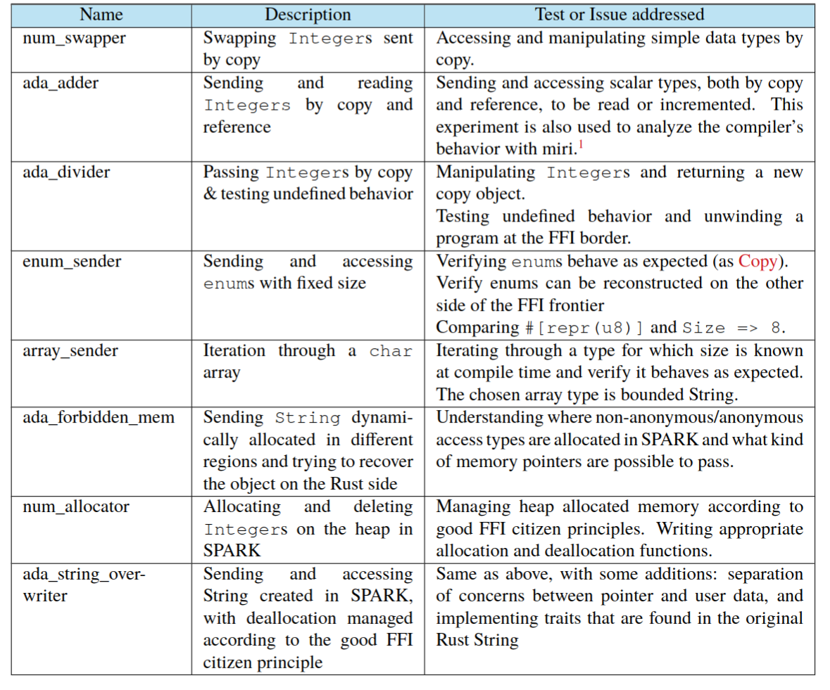
Experiments (1) SPARK → Rust
Experiments

Slide 17
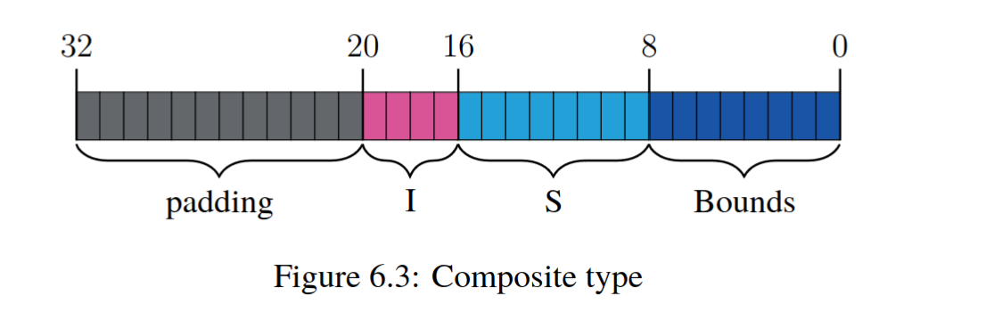
Experiments overview
Stack types:
- simple types, aggregates, composite types
- focus on type safety (memory safety and ownership taken care by the compiler for Copy)
- working with docs which is compiler specific
- working with layout
- calling functions in the other language
- demonstrating memory errors, undefined behavior
- memory safety verified with valgrind
Experiments

Slide 18
Experiments overview (2)
Heap types:
Same as stack types, but in addition:
- defining data structure (“extra wrapper”) to hold complex and nested data types
- implementing native methods/traits for creating, accessing, and modifying
complex data types
- “good FFI citizen”: Implementing method/traits for dereferencing and dropping memory
after usage
- minimizing unsafe code and delegating to the language semantics as much as possible
// One function allocates memory for a new object.
extern fn ECDSA_SIG_new() -> *mut ECDSA_SIG;
// And another accepts a pointer created by new
// and deallocates it when the caller is done with it.
extern fn ECDSA_SIG_free(sig: *mut ECDSA_SIG);
J. Gjengset, Rust for Rustaceans [7]
Experiments

Slide 19
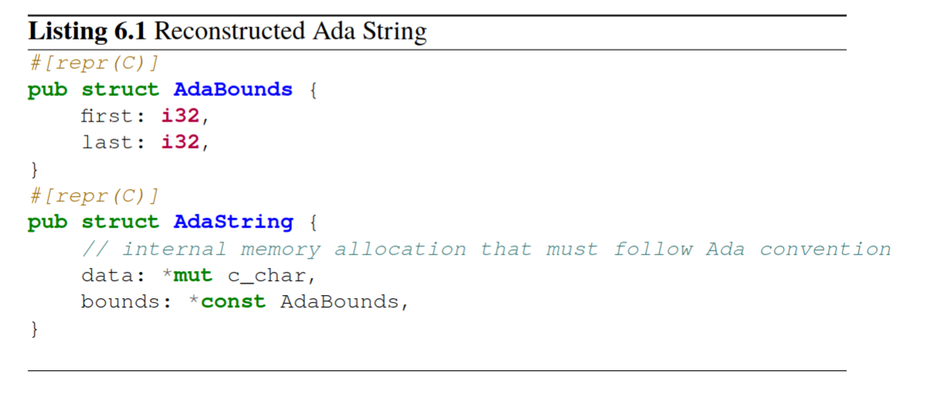
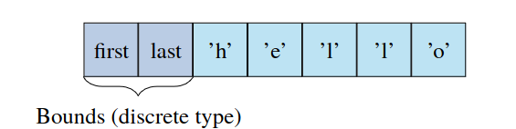
Example: one SPARK String
- String is a heap type: we need first to find correct sub-types (i32? c_char or u8?)
- Fat pointer (bounds + array)
- Finding instructions in the GNAT compiler book: bounds come last when FFI with C conventions.
- It follow the C ABI
Experiments

Slide 20
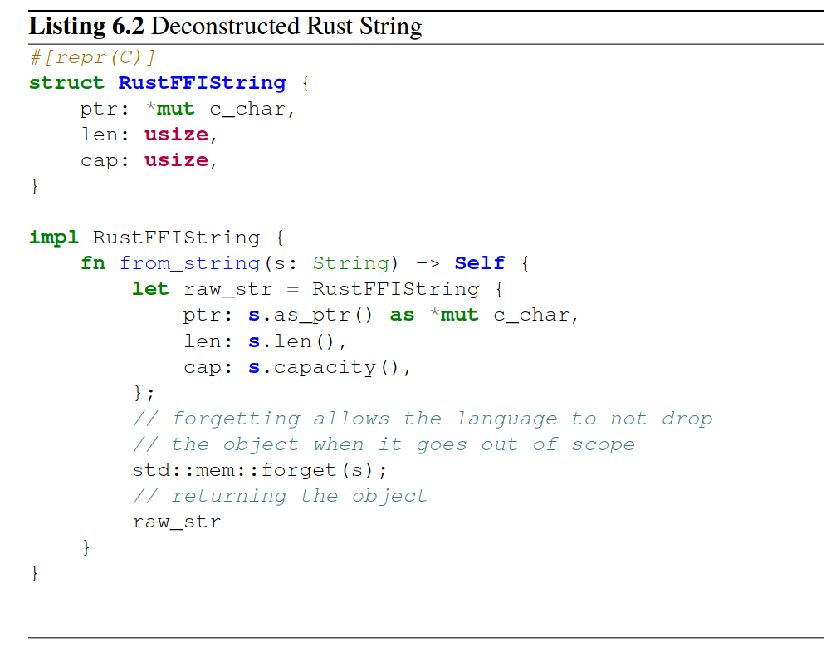
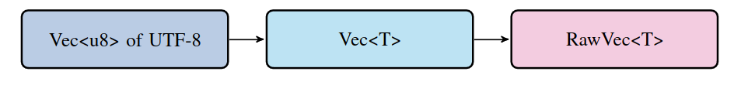
Example: one Rust String
- String is still a heap type
- Still a fat pointer with capacity, len, buffer
- It is not FFI safe and cannot be exported
- must be encoded as c_char for Ada/SPARK, len and capacity are not Integers!
- forgetting must be implemented
Experiments

Slide 21
BBQueue
Header and Grants
Grant has a reference to the header
The Grant can atomically touch the variables of the header
Experiments

Slide 22
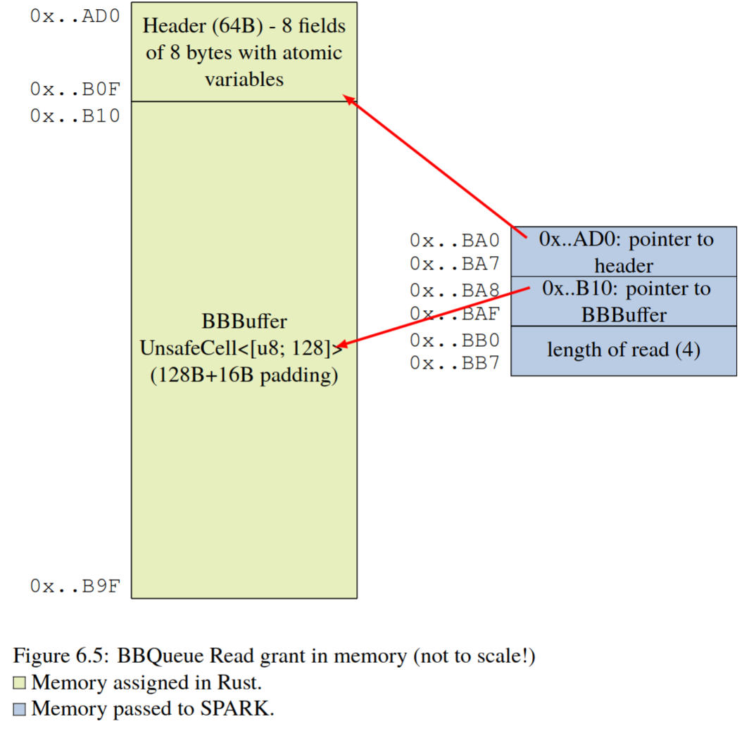
BBQueue
We must:
1. guarantee consistent layout across the FFI border (guaranteed by the data structure);
2. provide pointers to the grant and the content of the header;
3. ensure that the header fields are of the right size and are atomic;
4. ensure the absence of undefined behavior where it can be introduced;
5. ensure the functions in SPARK interact with the atomic variables in the exact prescribed order — to guarantee thread safety;
6. Respect the good FFI citizen principles.
Experiments

Slide 23
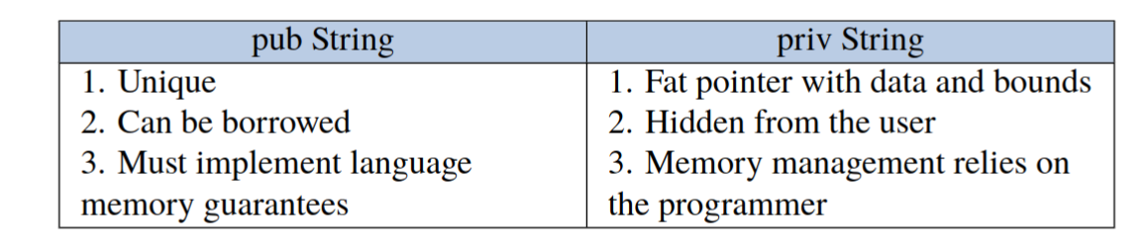
Results 1
- Rely on documentation. It is spread between language and compiler docs.
- Good FFI citizen (do not unwind, clean) is a must and empirically no memory errors were found with valgrind
- References cannot be used across FFI! Back to pointer logic.
- It is extremely error prone as per literature.
- Use separation of concerns

Slide 24
Results 2: memory interaction
- Some memory regions are inaccessible. SPARK must use named pointers. Rust has Allocator trait but not stabilized.
- SPARK is less flexible in its ownership (no lifetimes) in some respects (assumes ownership over the whole array in one function, no slicing)!
- But SPARK is more flexible in memory allocation: storage pools
- SPARK is more flexible to interact with external code/Rust protects most types

Slide 25
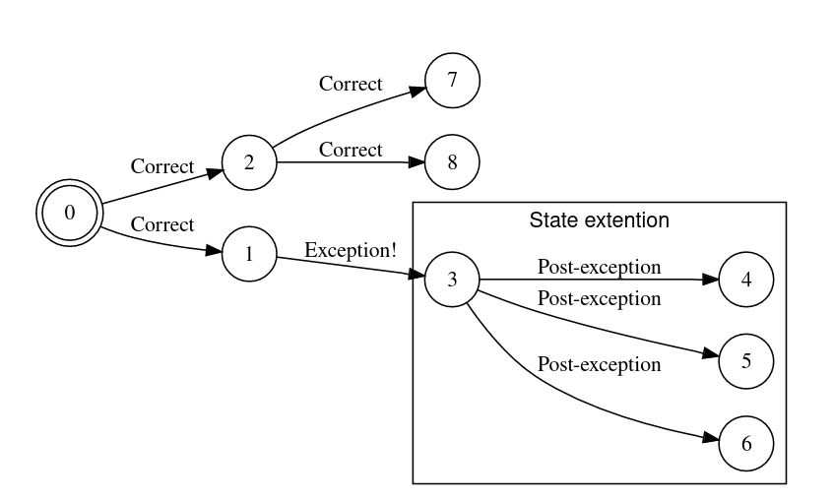
Results 3: Exceptions and panic!()
- unwinding across FFI is undefined behavior
- in microcontrollers it is impossible to unwind
- it is bad FFI citizen behavior!
- SPARK has no support for exceptions
- we can never go back to a “safe” state

Slide 26
Results 4: automated tool
It is feasible
The documentation is compiler specific, and squattered around
If being careful the consistency of Rust SPARK is conserved,
but in case of error we are back to the weakest link
→ It becomes extremely easy to ”lie” to the compiler
Strong reliance on the C ABI
Use compiler flags and conventions abundantly
[no_mangle] [repr(C)], Ada_Pass_By_Reference

Slide 27
Future work
Find and automatize information about types
Study of Bindgen
Rewrite of BBQueue

Slide 28


Thank you for coming to my Ted talk

Slide 29
THANK YOU
[1] S. Li, “Improving Quality of Soft ware with Foreign Function Interfaces using Static Analysis,” Doctoral dissertation, Lehigh University, 2014. Accessed: Feb. 13, 2023. [Online]. Available: https://www.semanticscholar.org/paper/Improving-Quality-of-Soft-ware-with-Foreign-using-Preserve-Li/8d0b6db3858946c27657567d42f684a32d34e4f3
[2] S. Mergendahl, N. Burow, and H. Okhravi, “Cross-Language Attacks,” in Proceedings 2022 Network and Distributed System Security Symposium, San Diego, CA, USA: Internet Society, 2022. doi: 10.14722/ndss.2022.24078.
[3] R. Pereira et al., “Energy efficiency across programming languages: how do energy, time, and memory relate?,” in Proceedings of the 10th ACM SIGPLAN International Conference on Software Language Engineering, in SLE 2017. New York, NY, USA: Association for Computing Machinery, Oct. 2017, pp. 256–267. doi: 10.1145/3136014.3136031.
[4] “NSA Releases Guidance on How to Protect Against Software Memory Safety Issues,” National Security Agency/Central Security Service, 2022. https://www.nsa.gov/Press-Room/News-Highlights/Article/Article/3215760/nsa-releases-guidance-on-how-to-protect-against-software-memory-safety-issues (accessed Feb. 13, 2023).
[5] L. Soares, “Understanding Ownership in Rust with Examples,” Coinmonks, May 23, 2023. https://medium.com/coinmonks/understanding-ownership-in-rust-with-examples-73835ba931b1 (accessed May 24, 2023).
[6] J. Munns, “The design and implementation of a lock-free ring-buffer with contiguous reservations - Ferrous Systems,” Mar. 06, 2019. https://ferrous-systems.com/blog/lock-free-ring-buffer/ (accessed Apr. 28, 2023).
[7] J. Gjengset, Rust for Rustaceans. no starch press, 2021. Accessed: Mar. 06, 2023. [Online]. Available: https://rust-for-rustaceans.com

